Slide 1
Network Traffic Anomaly Detection Using Machine Learning .
MAJOR PROJECT PRESENTATION
Presenter :
Guided by :
Akshat Kumar
08419011621
Dr. Ashish Joshi

Slide 2
Introduction :
Why Network anomaly detection Needs machine learning :
CHALLENGES:
Processes High-Volume, High-Dimensional Data
Zero-Day Attacks
Learns and Adapts Over Time
Reduces False Positives
Adaptibility
Feature selection and dimensionality reduction techniques (like Random Forest ) improve accuracy and speed
Feature Extraction
Supervised and Unsupervised Learning
Automates Detection

Slide 3
Problem Statement :
Goals :
Preprocess and analyze the CICIDS2017 dataset
With the exponential growth of network traffic, traditional intrusion detection systems (IDS) face significant challenges in real-time threat detection. Conventional methods struggle to recognize zero-day attacks and require frequent updates to signature databases. This project aims to develop a robust anomaly detection system using machine learning, which can dynamically identify and classify network threats with high accuracy and efficiency. The focus is on preprocessing network traffic data, extracting relevant features, and applying multiple machine learning models to detect malicious activities effectively.
features selection using Random Forest
Train and compare multiple machine learning classifiers
Visualize and interpret model performance
Identify best-performing models for anomaly detection
Provide suggestions for real-time deployment and future improvement

Slide 4
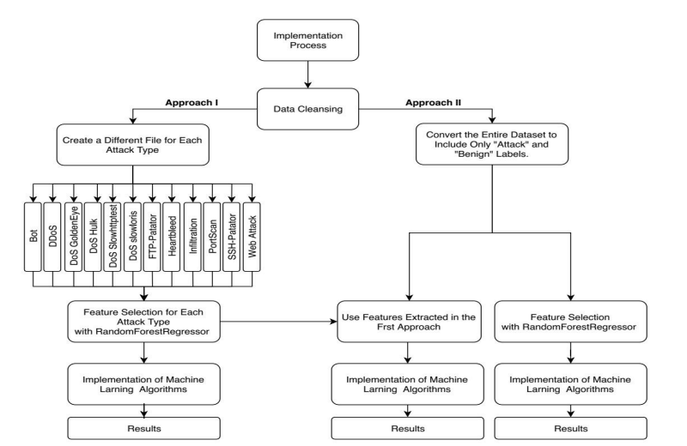
The Implementation Process:
Dataset Used-CICIDS2017
Data Cleaning
Create different files for approach.
Feature Selection
Model Training
Performance Evaluation
Final Optimization
Results Comparision

Slide 5
Why the CICIDS2017 Dataset Was Chosen ?
Published by the Canadian Institute for Cybersecurity.
contains realistic traffic.
capturing both normal and attack behavior in a simulated network environment.
includes:
1) brute-force attacks
2) Denial of Service (DoS)
3) infiltration
4) web based threats
contains over 3 million entries
data collection spanned 5 days, from Monday to Friday
Has broad range of modern attack types and inclusion of benign traffic generated through realistic user profiles.

Slide 6
Project Architecture :
01_preprocessing & 02_statistics :
This script handles the initial and crucial steps of data preparation and basic analysis..
Working :
It reads all the individual CSV files from the CICIDS2017 dataset.
It performs data cleaning operations on each file, such as removing corrupted rows, standardizing characters, and handling missing or infinite values by replacing them with placeholders or zeros.
It removes a redundant column from the dataset.
All cleaned and processed data from individual files are then merged into a single comprehensive file named all_data.csv.
It groups attack labels based on their frequency (high, medium, low) and generates bar graphs to visualize these distributions.
It also calculates and shows the overall ratio of benign to attack traffic.

Slide 7
03_attack_filter :
This script processes the combined dataset to create separate, balanced datasets for each type of network attack.
Working :
It reads the all_data.csv file generated by the previous script.
For each distinct attack type present in the dataset, it creates a new individual CSV file.
Each of these new files contains all the records corresponding to that specific attack type.
To create a more balanced dataset for training, it randomly samples benign (normal) records and adds them to each attack-specific file, maintaining a 30:70 ratio of benign to attack records.
These newly created files are saved in an 'attacks' subdirectory.
It then consolidates different "Web Attack" types (like XSS, Brute Force, SQL Injection) into a single Web Attack.csv file and removes the individual web attack files.

Slide 8
04_1_feature_selection_for_attack_files & 04_2_feature_selection_for_all_data :
This program is designed to identify and rank the most influential features in the dataset for distinguishing between attack and benign traffic.
Working :
It can operate either on the individual attack files (from the 'attacks' folder) or on the entire all_data.csv.
It uses the Random Forest Regressor algorithm to determine feature importance.
Uses Random Forest Regressor to find and rank the most important features for distinguishing attacks from benign traffic, either per-attack or for all data. It saves plots of top features and a list of the very top ones
Ml_ classifier for each attack :
05_1_machine_learning_implementation_for_attack_files
05_2_machine_learning_implementation_with_18_feature
05_3_machine_learning_implementation_with_7_feature
Working :
Trains and evaluates multiple machine learning models (Naive Bayes, RF, KNN, etc.) on each individual attack-specific dataset created by script 2. This helps see which models best detect specific attack types.

Slide 9
Ml_classifiers_for_all_data :
05_4_machine_learning_implementation_final
Working :
Trains and evaluates the same suite of ML models on the entire all_data.csv, treating all attacks as one class. It uses selected important features and multiple runs for robust F1-score, precision, recall, and accuracy metrics.
Ml_classifiers_feature_measure_comparison :
05_4_ml_f_measure_comparison
Working :
Fine-tunes feature selection for Naive Bayes, QDA, and MLP. It uses a greedy approach to find the optimal feature set for each of these models based on F1-score and then records their final performance.

Slide 10
Technical Environment and Tools :
Programming Language :
Python 3.6 is used for all implementation files.
Key Libraries :
Sklearn for machine learning
Numpy for mathematical operations
Pandas for data analysis
Matplotlib for graphics
Execution :
Files are available in both .py and .ipynb formats, with Jupyter Notebook enabling output visualization without rerunning.

Slide 11
Results Highlights :
CICIDS2017. Feature selection via Random Forest Regressor.
Overall Best F-Measures:
KNN: 0.96
ID3: 0.94
AdaBoost & Random Forest: 0.93
Feature Optimization Impact :
QDA showed largest F-measure gain (+0.45) after model-specific feature tuning.
NB & MLP also improved.
Reducing features (e.g., to top 7) significantly cut training times while maintaining comparable F-measures for many models.
Comparative Analysis (vs. Sharafaldin et al. [7]):
This study excelled with AdaBoost (+0.16 F-M) and MLP (+0.06 F-M))
Sharafaldin et al. better with QDA, RF, ID3.

Slide 12
Conclusion & Key Takeaway :
Project Success: Effectively demonstrated network anomaly detection using various ML models on the CICIDS2017 dataset.
Top Performers (F-Measure) :
KNN: 0.96 (Highest accuracy)
ID3: 0.94
AdaBoost: 0.93
Fastest Model : Naive Bayes (NB) consistently showed the quickest processing times.
Key Takeaway : Classical machine learning, with optimized feature selection, provides a highly accurate and viable solution for network security.

Slide 13
Future Scope :
Real-Time Implementation: Develop modules for live traffic ingestion and processing.
Hierarchical Model Architecture:Use lightweight models (NB, QDA) for initial real-time screening.
Employ high-performance models (KNN, ID3) for deeper, refined detection.
Aim: Optimize resource use, maintain accuracy, and improve scalability.

Slide 14
The End of Presentation
Thank you for Listening
Presenter :
Guided by :
Akshat Kumar
08419011621
Dr. Ashish Joshi

